Slide 1

Live Voice Social Media
Notes:
[:55] Hi I’m Brian Burt I’m the CEO, and I’m excited to share with you about our breakthrough technologies in creating interactive voice conferencing. My career is in leading large-scale technology projects and often involving telecommunications. For example, all the inbound calls at Charles Schwab & Company come in through a system I spearheaded.v
Now, we’re different than some of the seed-stage companies you might encounter. We have raised more than $600k, have launched, and already have more than 750 paying customers.
Why? Because our customers have a problem. They have people around the country and they want to create effectively engage them for learning, for driving a change in behavior, and in driving sales. And their current solution? I’m sure many of you are familiar.
How many of you have been on a conference call with more than 10 people on it?
And how many of you checked your email, surfed the web or otherwise multi-tasked during the call?

Slide 2

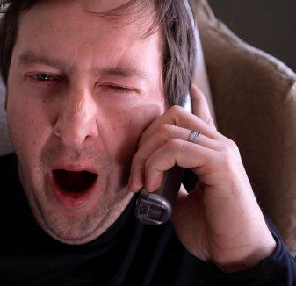
The Problem…
Voice events today,
webinars and
conference calls…
"One person talking, and 100 people
falling asleep...”
Notes:
[1:20] Traditional large conference calls are generally really boring. They are closer to passive media like radio or podcast than an interactive experience like a live meeting. This doesn't keep people engaged, learning, inspired ... or even awake.
MaestroConference addresses this problem by bringing the interactive dynamics of a live room to an audio conference . Let's talk about how we do this in the context of some of our customers.

Slide 3




The Evolution of Social
Media & Conferencing
Usenet
&
BBS
Static
Web
Pages
User
Forums
Online Social
Media
Phone
Calls
3-way
Calling
1⁻to⁻Many
Conf.
Calls
Social
Conferencing

Slide 4
The Shift:
A Scalable & Truly Social Media
Imagine a conference call/webinar:
First, led by a respected/inspirational leader
Then breaking into small groups, applying the topic to their life, reflecting, sharing learnings
moving to fluid engagement: select which topics to join, vote, ask questions, take action
… all interwoven with online social media
Peer-to-peer voice - where strangers become friends and everyone moves into action
Notes:
[5:10]
One of the most exciting things is the size of the markets. To avoid billions in travels, especially IN THIS ECONOMY. Create value in five different industries, each of which we could build an entire business in.
Each of these has an immediate need to engage people for learning, change in behavior or sales.
[# of hosts / # of possible participants in each]

Slide 5
Mass Communications
 | Raw Emotion | Relevance: About Me? | Inspiring, Important | Builds New Relationships
Radio & TV | High | Low | Low | Zero
Conf. Calls & Webinars | Low | Med | Low | Low
Webforums & Blogs | Med | Med | Med | Low
Facebook | Med | High | Low | Med
 | High | High | High | High

Slide 6
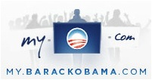






Current Customers
Our 750+ customers include:
Notes:
[2:10] Barack Obama has 17MM members.
Pampered Chef has 60,000 distributors.
Jack Canfield, who just sold the Chicken Soup for the Soul business for $50MM.
These customers have the problem of keeping people engaged, for learning, driving change, or sales. Here’s the solution.
[later … list problems?]

Slide 7
Best Uses
Ideal for bringing together communities around positive / aspirational topics
Engage in a global good (sustainability, ending poverty) or a personal good (health, consciousness, growing a biz)
Support a non-profit or cause
Create deep awareness of good works by a for-profit’s, non-profit’s, or other org
Move like-minded people into action: post an event to social media, write letters to editor, or make a donation
Notes:
[5:10]
One of the most exciting things is the size of the markets. To avoid billions in travels, especially IN THIS ECONOMY. Create value in five different industries, each of which we could build an entire business in.
Each of these has an immediate need to engage people for learning, change in behavior or sales.
[# of hosts / # of possible participants in each]

Slide 8
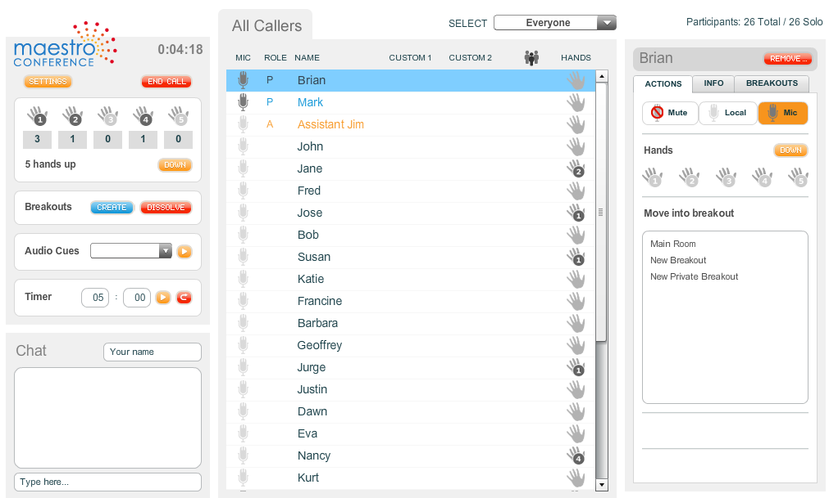
Our Features
Breakout Groups
  & “Walk the Room”
Hand-raising & Speaker Selection
Straw Polls … and One-touch Opt-In
Order-taking / Make Donations 1-1
Published APIs for easy integration
Scales currently to 1,000 and soon to events of 10,000 or more
Notes:
[4:10] Talking head vs.. MaestroConference.

Slide 9
Questions?
Please Contact:
Chris Kyle, Director of Sales
415-328-7905
chris.kyle@maestroconference.com

